Slide 1

Robust Video Data Hiding Using Selective Embedding and Forbidden Zone Data Hiding
Batch No: A-07 Project Guide:
D. R. Gowthami (164G1A0527) Mrs. T. Kavitha ,M.Tech.
K. Meena (164G1A0555) Assistant Professor
P. Bhargavi (164G1A0513)
Srinivasa Ramanujan Institute of Technology
Department of Computer Science & Engineering

Slide 2
Introduction
Data Hiding is the process of embedding information into a host medium.
Steganography is a technique for hiding secret information in digital image, audio and video to secure information from unauthorized users.
In this project, we hide data efficiently in video to increase the security for the data so that the data cannot be easily cracked.

Slide 3
Abstract
Video Data Hiding is still an important research topic due to Design Complexities involved.
We propose a new video data hiding method that makes use of erasure correction capability of repeat accumulate codes and superiority of FZDH.
Selective Embedding is utilized in the proposed method to determine host signal samples suitable for data hiding.

Slide 4
Existing System
In special domain, the hiding process such as Least Significant Bit(LSB) replacement, is done in special domain while transform domain method, hide data in another domain such as wavelet domain.
Least Significant Bit is the simplest form of steganography. LSB is based on inserting data in the least significant bit of pixels, which lead to a slight change on the cover image that is not noticeable to human eye. Since this method can be easily cracked, it is more vulnerable to attacks.

Slide 5
Proposed System
In this project, we propose a new block base selective embedding type data hiding framework that encapsulates FZDH.
To provide security for the data we use DES algorithm. By means of simple rules applied to the frame markers, we introduce certain level of robustness against frame drop, repeat and insert attacks.

Slide 6
Problem Statement
During video data hiding the quality of the image cannot be preserved. They cannot survive any format conversion without any significant loss of perceptual quality.
LSB is based on inserting data in the least significant bit of pixels, which lead to slight change on the cover image that is not noticeable to human eye. Since this method can be easily cracked. It is more vulnerable to attacks. Here, We hide data efficiently in video and preserve the quality from the external attacks.

Slide 7
Module Description
MODULES
Input Module :
ENCRYPTION MODULE
DECRYPTION MODULE
DES

Slide 8
Input Module
The Input Module is designed as such a way that the proposed system must be capable of handling any type of data formats, such as if the user wishes to hide any image format then it must be compatible with all usual image formats such as jpg, gif, bmp, it must be also compatible with video formats such as .avi, .flv, .wmf etc.. And also it must be compatible with various document formats, so that the user can be able to use any formats to hide the secret data.

Slide 9
Encryption Module
In Encryption module, it consists of Key file part, where key file can be specified with the password as a special security in it. Then the user can type the data or else can upload the data also though the browse button, when it is clicked the open file dialog box is opened and where the user can select the secret message. Then the user can select the image or video file through another open file dialog box which is opened when the cover file button is clicked. Where the user can select the cover file and then the Hide button is clicked so that the secret data or message is hidden in cover file .

Slide 10
Decryption Module
This module is the opposite as such as Encryption module where the Key file should be also specified same as that of encryption part. Then the user should select the encrypted cover file and then should select the extract button so that the hidden message is displayed in the text area specified in the application or else it is extracted to the place where the user specifies it.

Slide 11
DES
This module consists of same as Encryption and Decryption part using DES algorithm. The Data Encryption Standard (DES) is a block cipher that uses shared secret encryption.

Slide 12
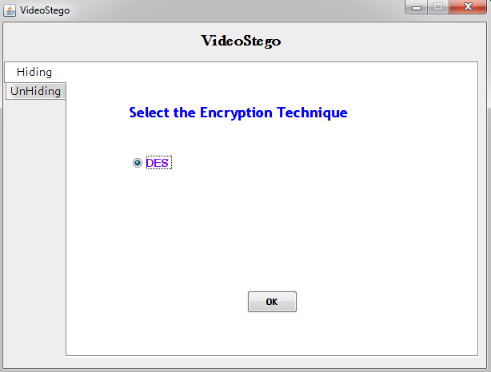
Output
Algorithm Selection

Slide 13
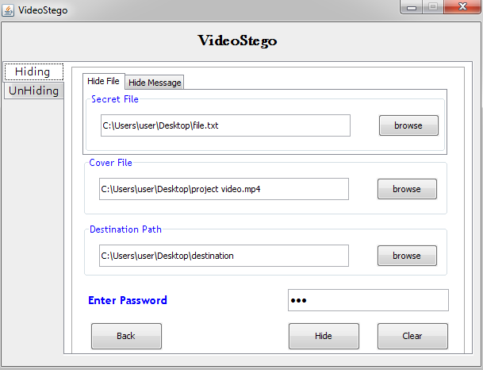
Hiding Secret Data
Uploading Files

Slide 14
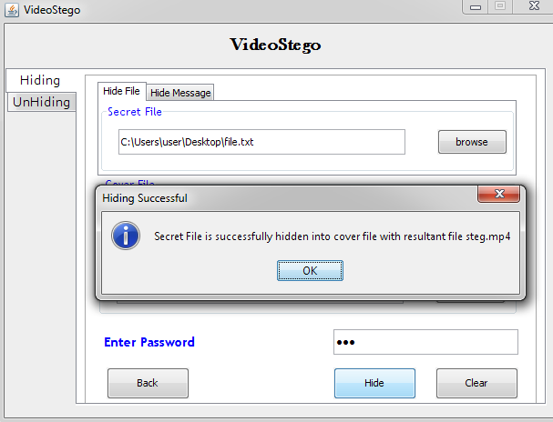
Contd…
Successful Hiding

Slide 15
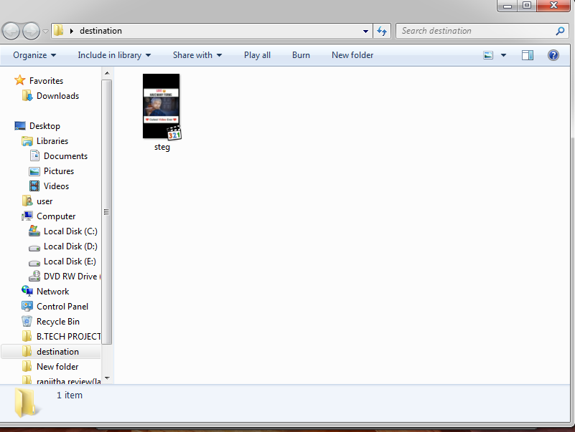
Contd…
Video With hidden data

Slide 16
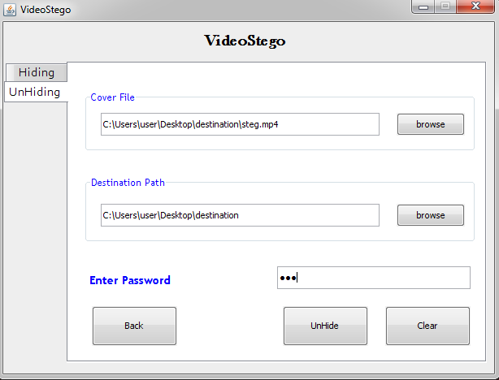
Unhiding Secret data
Uploading Video file

Slide 17
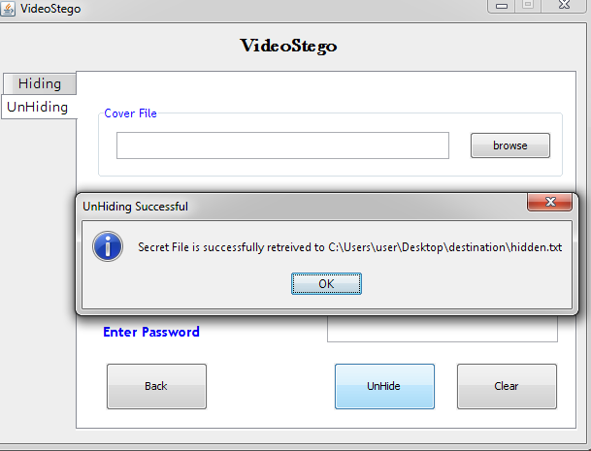
Contd…
Retrieving Secret data

Slide 18
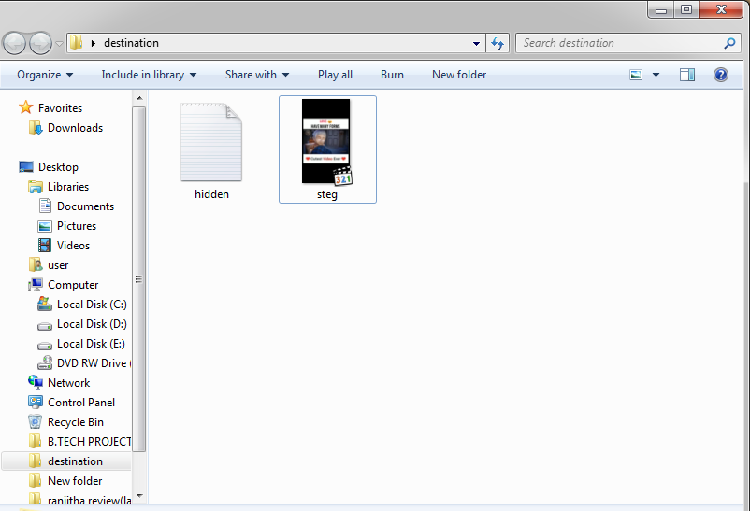
Contd…
Retrieved secret data from video

Slide 19
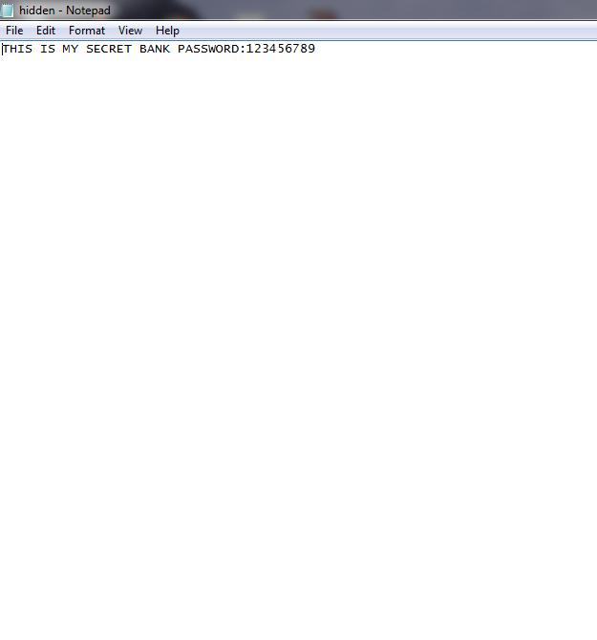
Contd..
Secret data Retrieved

Slide 20
Conclusion
we propose a new video data hiding framework that makes use of erasure correction capability of frame dropping. The method is also robust to frame manipulation attacks via frame synchronization markers. The framework is tested with MPEG, FLV and scaling and frame-rate conversion attacks.
The proposed framework is tested by typical broadcast material against MPEG frame-rate conversion attacks, as well as other well-known video data hiding methods.

Slide 21
References
[1] S. K. Kapotas, E. E. Varsaki, and A. N. Skodras, “Data Hiding in H- 264 Encoded Video Sequences,” in IEEE 9th Workshop on Multimedia Signal Processing.
[2] A. Sarkar, U. Madhow, S. Chandrasekaran, and B. S. Manjunath,“Adaptive MPEG-2 Video Data Hiding Scheme,” in Proceedings of SPIE Security, Steganography, and Watermarking of Multimedia Contents.

Slide 22
Thank you
Queries
?

